Slide 1


Slide 2

Pressing Matters
How to have hard conversations
Jenny McDonald. MSc.
16 July

Slide 3
Today
What is a hard conversation ?
Frameworks for planning
Effective skills
Application

Slide 4
Let’s Get Real
Think of a real conversation you have had or one you are planning to have and apply the frameworks to that.
Comment in Chat please

Slide 5
What is a Hard Conversation?
Any conversation that you find potentially hard, awkward or difficult

Slide 6
Why Do We Need to Have Hard
Conversations?
Issues fester and get in the way of effective relationships
Having conversations in our head is tiring and rarely resolves anything
When something needs to be sorted
Your examples?

Slide 7
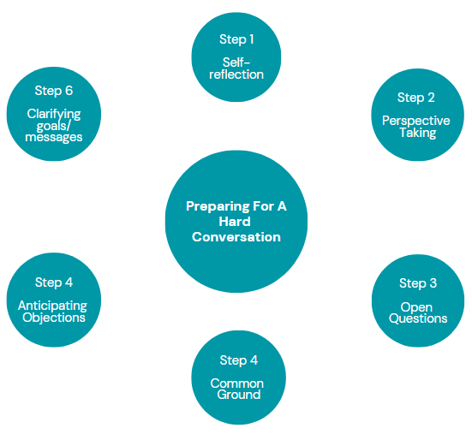
Preparing for
Difficult
Conversations

Slide 8
Self
Reflection

Slide 9
Self Reflection
What’s going on for you?
Briefly capture the issue/situation and any assumptions you have
Sensory Data (the facts)
Thoughts (your story)
Actions so far
Wants – yours and maybe other people
Emotions – can you name them?

Slide 10
Perspective Taking
What do you know about what’s going on for them?
Briefly describe the issue situation
Sensory Data (as they see it)
Thoughts – do you know what they are thinking?
Actions – what have they done so far ?
Wants – what are they looking for ?
Emotions – how do they feel ?

Slide 11
Difficult Conversations
Clarifying Goals/Messages
What are the key goals and outcomes you have for the conversation?
What are the 3-5 key messages you want to weave into the conversation?

Slide 12
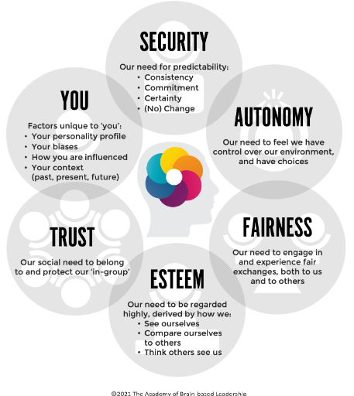

Psychological
Safety – You
And Others

Slide 13
Difficult Conversations - Skills
Common Ground
What do you both want and what can you agree on ?
Anticipating Objections
Consider what objections the other person may raise in the conversation, and how might you deal with them ( it might help to practice with a supportive colleague or friend)
Use of open questions
e.g. Can you tell me more about that ? What is important to you in relation to this issue ? What does success look like for you?
How would you know that this issue is resolved ? Is there anything else you need in order to move on ?

Slide 14
Listening
Listening for Gaps - wait my turn, waiting for the opportunity to speak next
Listening for Words - predicting what the other person is going to say. I hear the word and quickly attach my own meaning to that word - making lots of assumptions - my interpretation of the words
Gotcha listening
Listening for where you can correct the speaker
Listening for Intention - purposeful effort to understand what the other person is trying to say - seek to clarify and understand - engagement - generosity of spirit and patience - stay curious

Slide 15
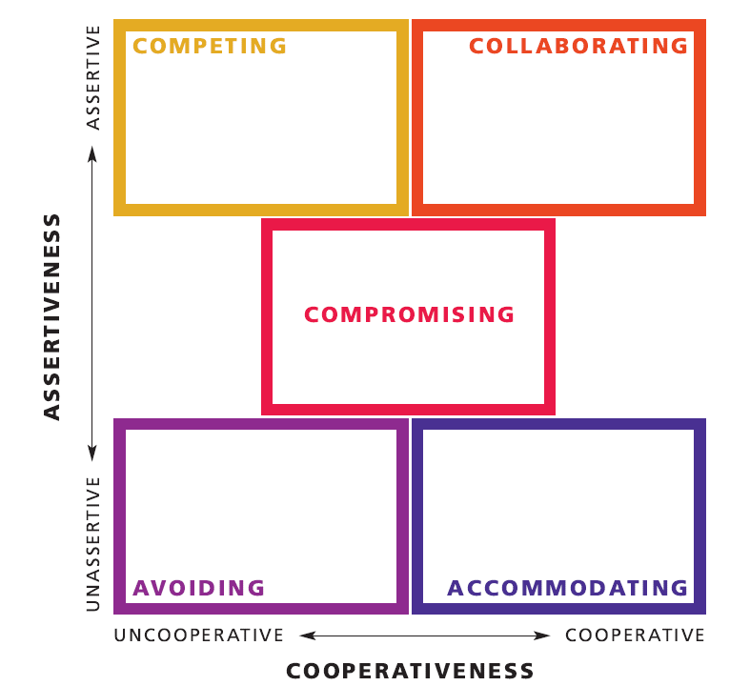
Thomas-Kilmann Conflict Handling Modes -
Which do
You use ?

Slide 16

Application
As you consider your example now, what has changed?

Slide 17
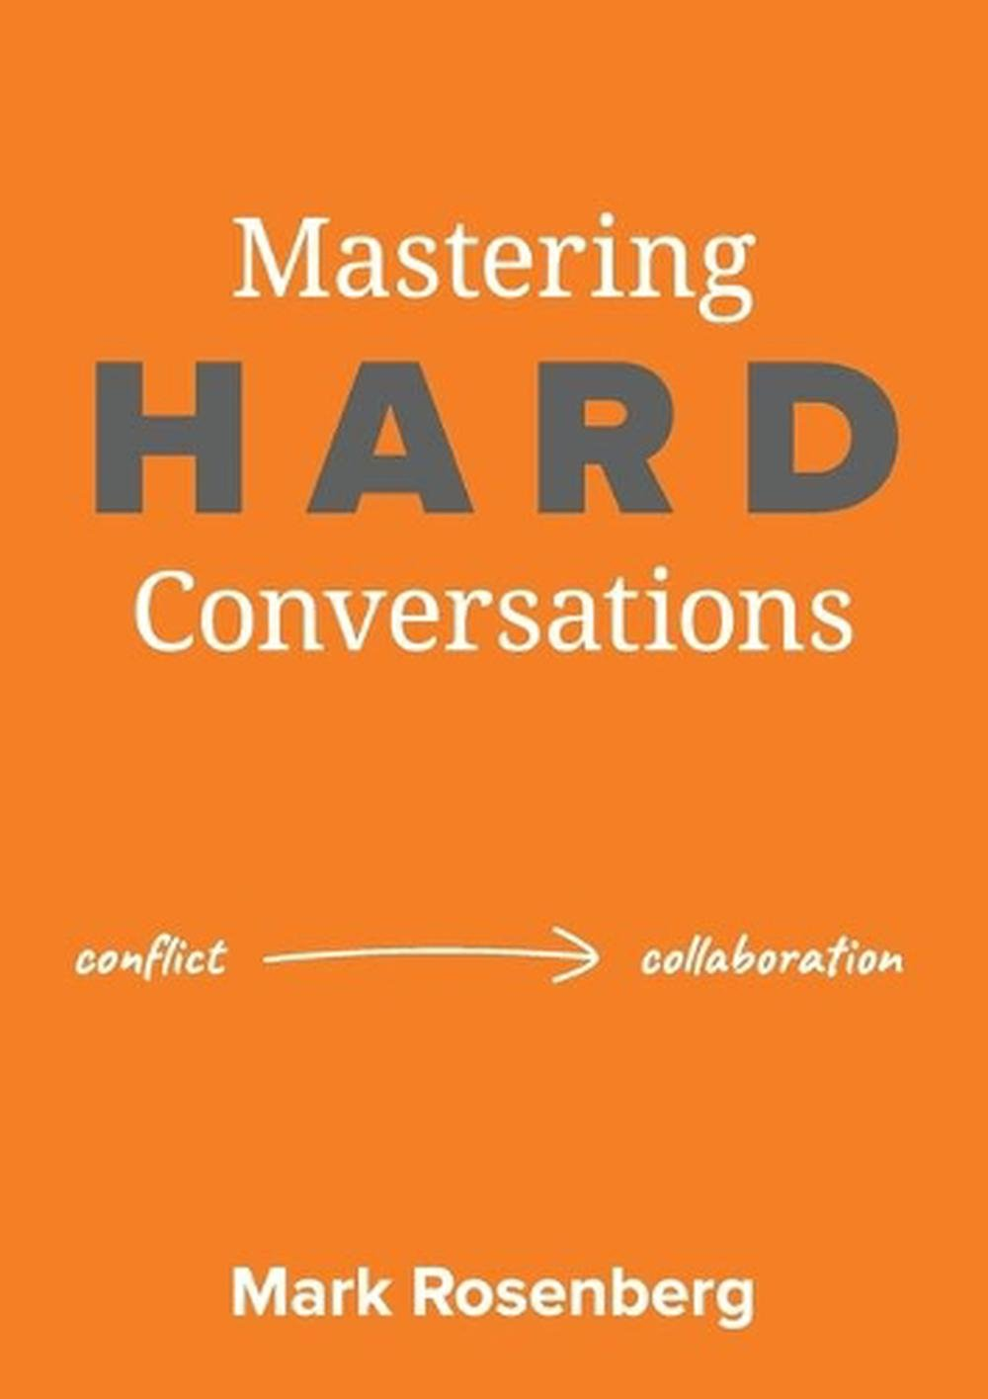

Slide 18
Thank You
Jenny McDonald. MSc.
16 July

